Slide 1
Behaviour Driven Development
(BDD)

Slide 2
Agenda
Introduction to BDD
Why BDD?
Implementation
Advantages of BDD
BDD tools
BDD Example in Specflow
Exercise

Slide 3
Introduction
BDD definition by Dan North
BDD is a second-generation, outside-in, pull-based, multiple-stakeholder, multiple-scale, high-automation, agile methodology.
Using examples at multiple levels to create a shared understanding and surface uncertainty to deliver software that matters.

Slide 4
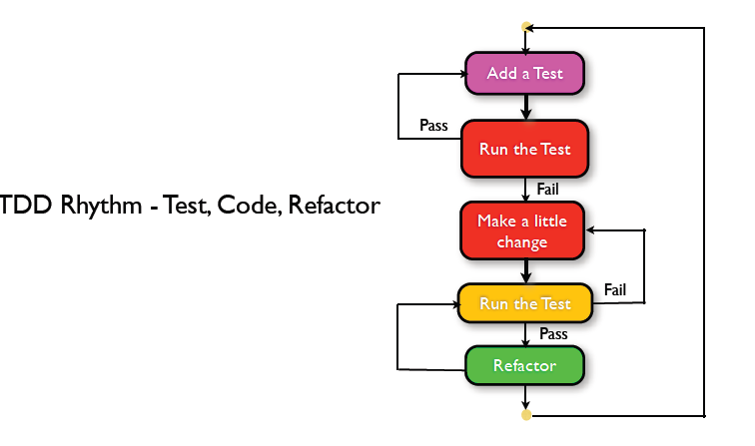
Why BDD?
BDD is evolved from TDD
TDD – Test Driven Development
Test Driven Development encourages writing test code before developing

Slide 5
Why BDD ? cont...
Idea is to govern software development by both technical skill and business interests
Dan North created the first BDD framework ‘JBehave’
Developed as replacement for Junit (Unit test framework)
Removed reference to tests and replaced it with vocabulary verifying ‘Behaviour’
Dan North and Chris Matts stated describing acceptance criteria in terms ‘Given-When-Then’ format

Slide 6
Implementation
Requirements , User stories & Feature
Requirements needs to be converted into user stories with example
User stories are explained in ‘Role – Feature – Reason ‘ format
User stories are short and complete description of capabilities from user perspective
As a <Role> I want<Feature> so that<reason>
As a <Who> I want <What> so that <Why>
Eg :
As a <Owner> I want < to add my properties> so that <I can manage property related details easily>

Slide 7
Implementation Cont.…
User stories are mapped to Features
Eg : As a <Owner> I want < to add my properties> so that <I can manage property related details easily> ---story
Story is mapped to Feature ‘ Add New Property’
A feature will have many scenarios
scenario 1: Owner able to add property with Tenant details
Scenario 2 : Owner able to add property with out tenant details
Scenario 3 : Owner able to add property with home value
Scenarios are described in Gherkin format

Slide 8
Implementation Cont.…
User stories are acceptance criteria – if the system fulfils the acceptance criteria then system behaves correctly
Dan and Chris created template to describe acceptance criteria in terms of scenarios
Given <initial context> When <an event occurs >Then <ensure some outcomes>
Eg :
Given Owner logged into application
When owner add new property details
Then New property is added

Slide 9
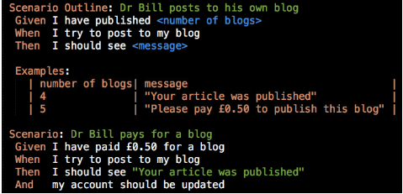
Implementation Cont.…
Gherkin format
Reserved keywords of Gherkin format
Scenario
Scenario outline
Given
When
Then
And
But
Examples

Slide 10
Implementation Cont.…
Best practice to write scenarios
Three Amigos - Business Analysts, Developers and Testers are involved in discussions to write stories
Business Analysts - specifies behaviours they want in the system
Developers - asks questions based on their understanding and add additional behaviours from development perspective
Testers - decides on which system behaviours the acceptance tests will be written

Slide 11
BDD –Benefits
Strong collaboration
High visibility
Follows business value
Helps lower costs & reduces risk

Slide 12
BDD Tools
Specflow, Cucumber, EasyB, Jdave,Concordion, jbehave,
Specflow :
It is testing framework to supports BDD
It lets us to write stories/behaviours of application in the Gherkin language
It runs on the Nunit .
All BDD tools needs unit test adapter to convert the scenarios into the tests

Slide 13
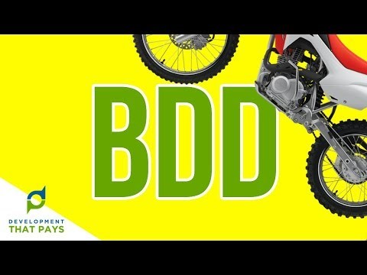

Slide 14
BDD Example in Specflow
Demo - Adding new property by a owner
http://new-keys.azurewebsites.net/

Slide 15
Try it out
Add Tenant feature and its scenarios

Slide 16
References
https://inviqa.com/blog/bdd-guide
https://dannorth.net/introducing-bdd/
http://www.modernanalyst.com/Resources/Articles/tabid/115/ID/3810/Gherkin-for-Business-Analysts.aspx

Slide 17
Thank U

